Slide 1
CONTROL STATEMENTS
Decision making is required when we want to execute a code only if a certain condition is satisfied.
The if,elif,else statement is used in python for decision making.

Slide 2
The if statement:
If statement is used for decision making operation.It contains a body of code which runs only when the condition given in the if statement is true..
Syntax:
if condition:
….execute when condition true…..
Flow chart

Slide 3
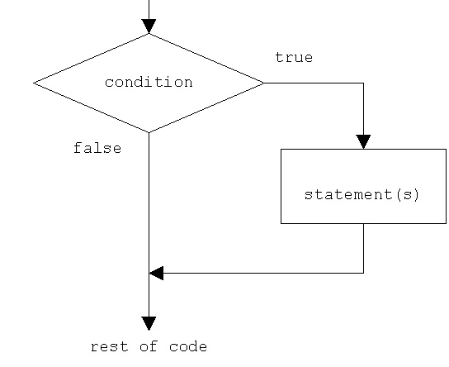

Slide 4
Example:
a=10
for i in range(a):
if i<10:
print(i)

Slide 5
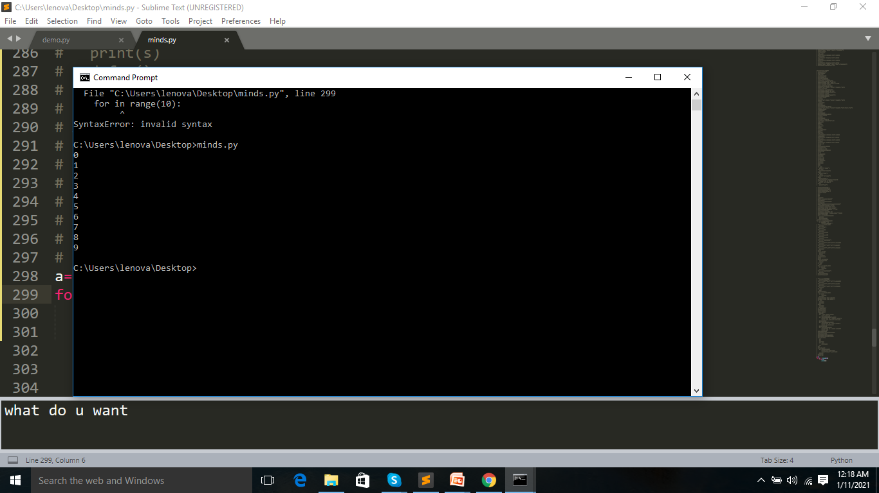

Slide 6
If….else statement:
If the if condition is false,the body of else is executed.
Syntax:
if condition:
statement
else:
statement

Slide 7
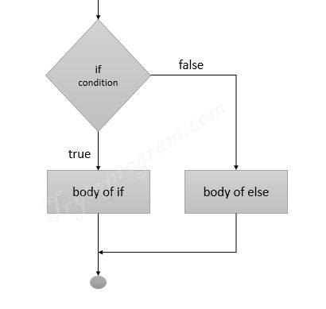
Flow chart:

Slide 8
Example:
a=11
for i in range(a):
if i>4:
print(i)
else:
print("value less than 10")

Slide 9
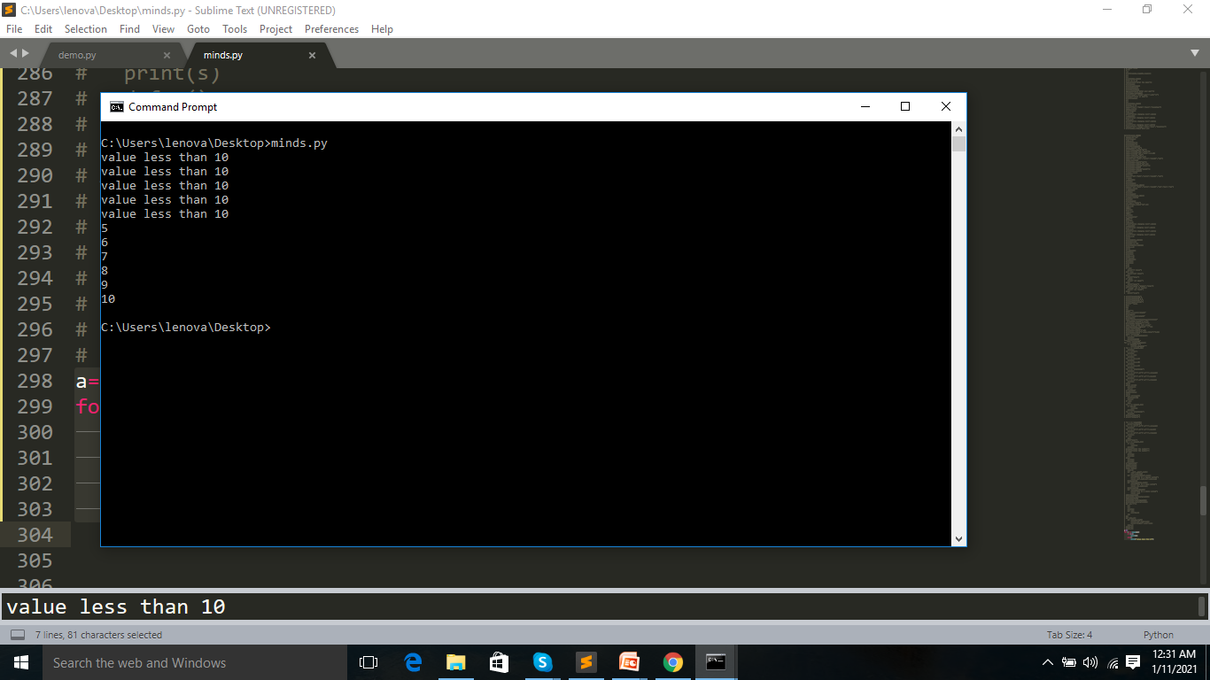

Slide 10
If…elif…else statement:
If the condition for if is false,it checks the condition of the next elif block and so on.
If all the condition are false,the body of else is executed.
Syntax
If condition:
…….statement…
elif condition:
……..statement…
else:
…..statement

Slide 11
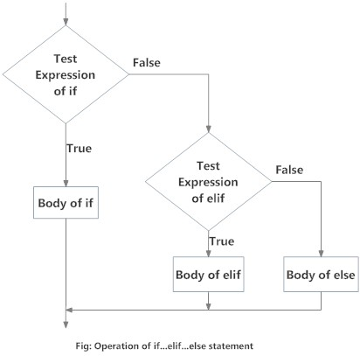
Flow chart

Slide 12
Example:
a=11
for i in range(a):
if i>15:
print(i)
elif i>5:
print(i)
else:
print("value less than 10")

Slide 13
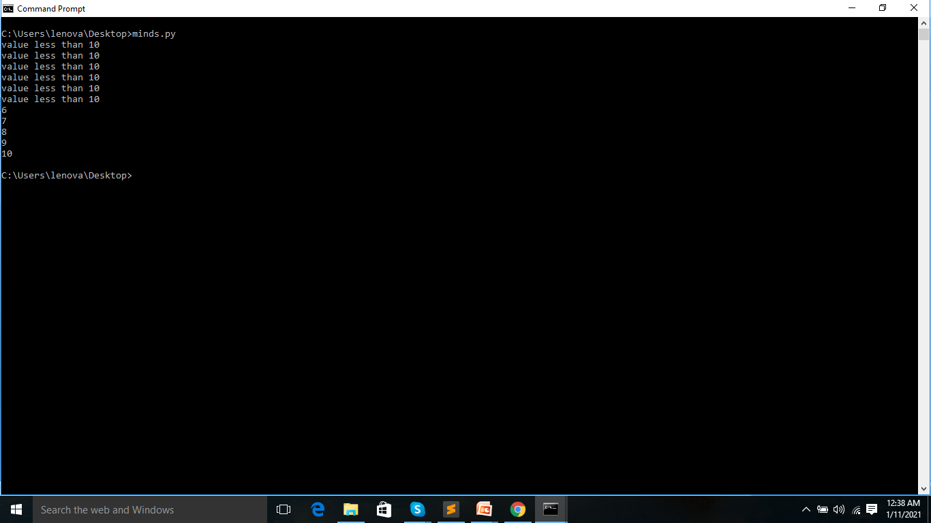

Slide 14
Nested if statement:
The if statement inside another if statement .
Syntax:
If condition1:
………execute condition 1…
If condition2:
……execute condition 2…..

Slide 15
Example:
a=11
for i in range(1,a):
if i!=0:
if i<10:
print(i)
else:
print("value greater than 10")
else:
print("value is zero")

Slide 16
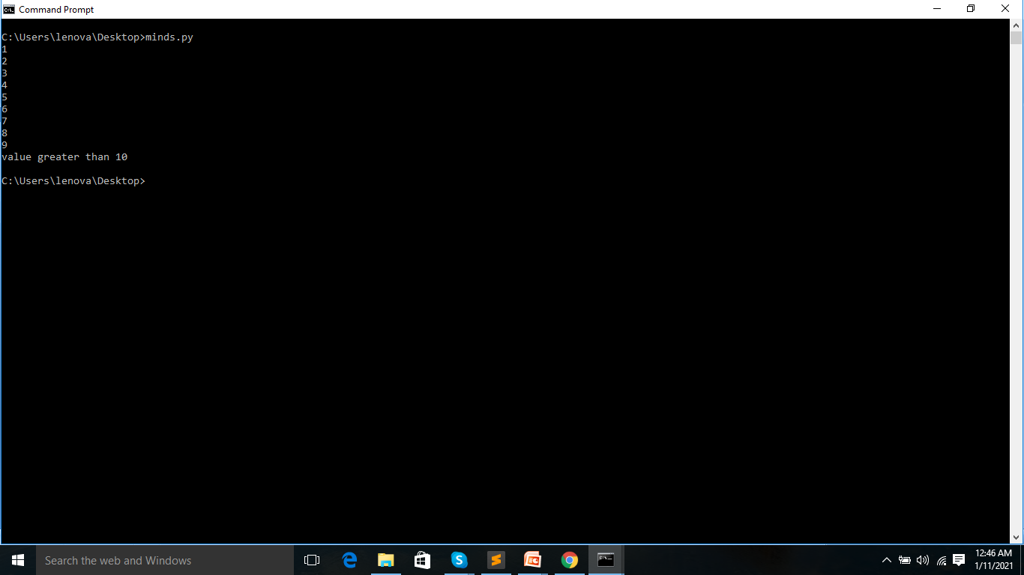

Slide 17
Pass:
The pass statement is useful for when you don’t write the implementation of a function but you want to implement it in the future.
Syntax:
continue
Example:
if 3>2:
pass
print(“hello”)

Slide 18
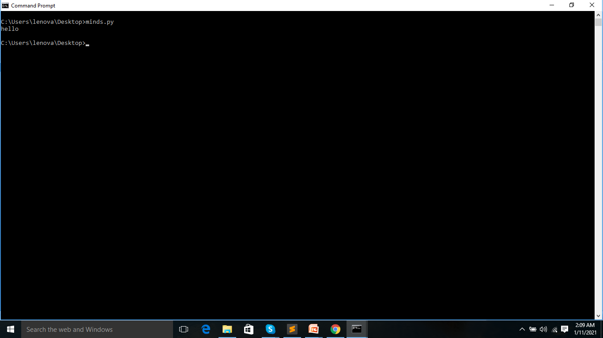

Slide 19
Break:
This statement terminates the current loop and resumes execution at the next statement.
Syntax:
break
Example:
for i in range(1,11):
if i==5:
break
print(i)

Slide 20
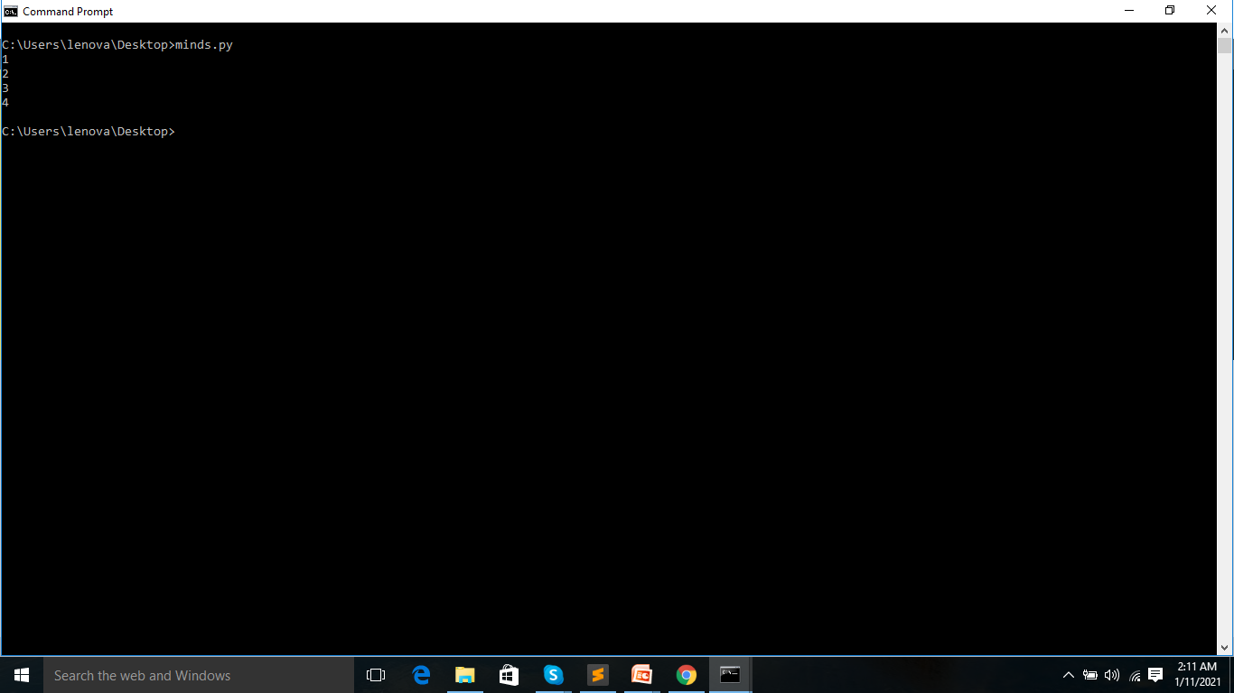

Slide 21
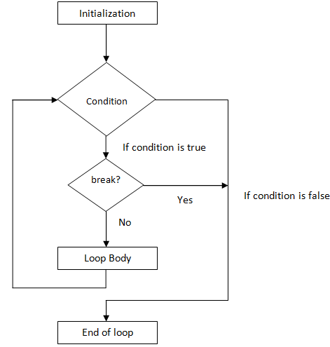
Flow chart

Slide 22
CONTINUE:
Continue statement in python is used to skip all the remaining statements in the loop and move controls back to the top of the loop.
Syntax:
continue
Example:
for i in range(1,11):
if i%2==0:
continue
print(i)

Slide 23
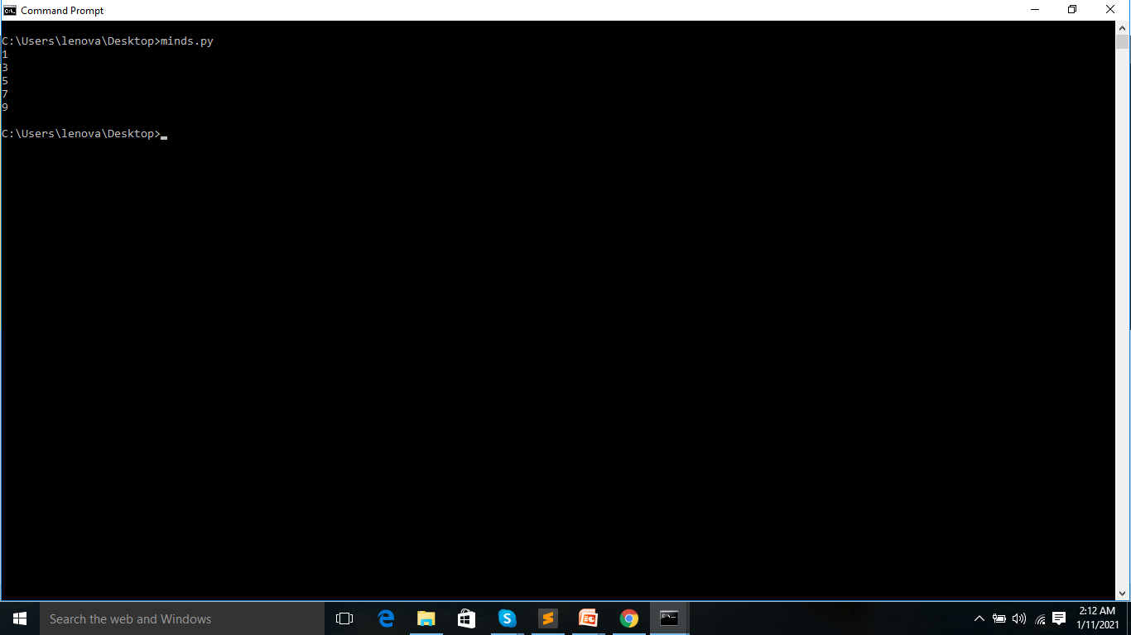

Slide 24
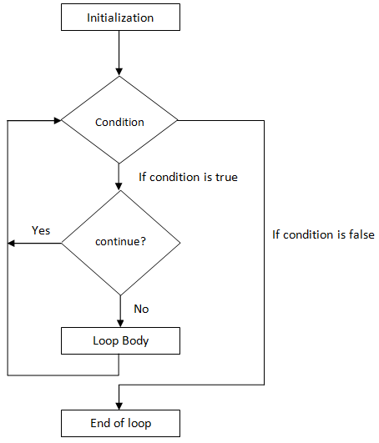
Flow chart

